Slide 1
Litter of Light: Case Study
A Sustainable Lighting Solution for Off-Grid Communities
https://www.youtube.com/watch?v=hYixZL5ijQw
https://www.youtube.com/watch?v=cQCHvO2H0_0
https://www.youtube.com/watch?v=nrL3mXcBPtM
In India

Slide 2
Introduction
Litter of Light is a social enterprise that provides low-cost, sustainable lighting solutions for underserved communities. Founded by Illac Diaz, the initiative upcycles plastic bottles to create solar-powered lights for off-grid areas.

Slide 3
Problem Identification
Millions of people in developing countries live without access to reliable electricity, relying on dangerous and costly alternatives like kerosene lamps. This lack of lighting affects education, productivity, and safety, especially after dark.

Slide 4
Solution
Litter of Light provides a sustainable solution by creating solar-powered lights using discarded plastic bottles. These lights harness daylight and can be locally produced and installed, providing affordable lighting for off-grid areas.

Slide 5
Implementation
1. Partnerships with local governments, NGOs, and corporations.
2. Community training to produce, install, and maintain solar lights.
3. Global expansion across 30+ countries with focus on local empowerment.

Slide 6
Impact
Litter of Light has improved the lives of over a million people, saving money on energy, reducing health risks, and allowing children to study at night. It also helps reduce plastic waste by upcycling discarded bottles.

Slide 7
Challenges
1. Funding for expansion and sustainability.
2. Ensuring long-term maintenance in remote areas.
3. Scaling the initiative across more countries.

Slide 8
Conclusion
Litter of Light offers a sustainable, scalable solution to energy poverty. By empowering communities to produce their own lights and upcycling plastic waste, it creates economic, environmental, and social benefits, setting an example for global development.

Slide 9
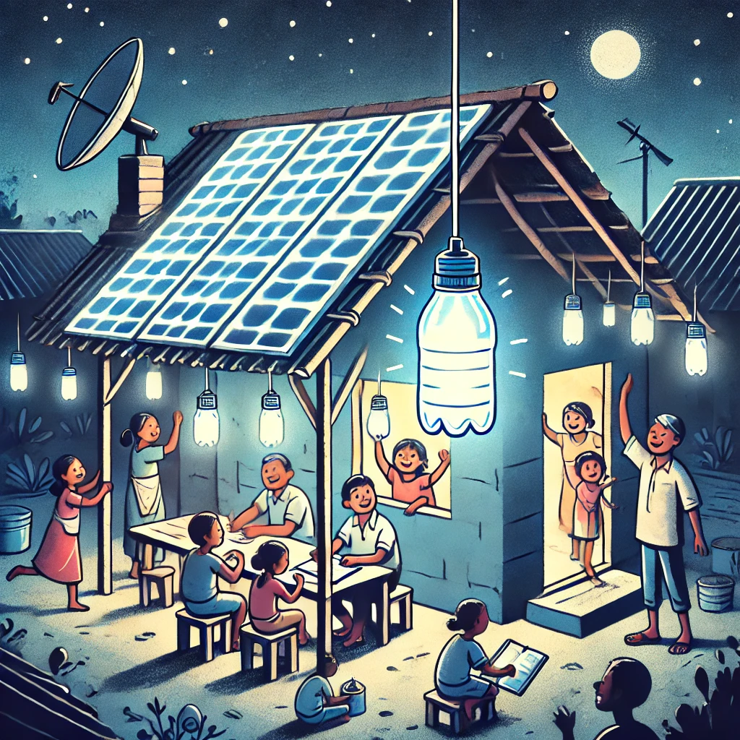
Illustration of Litter of Light

